Slide 1
Introduction to Data Science and Machine Learning -
Raghu Prasad K S
9845547471
Infidata Technologies

Slide 2
Introduction
Raghu Prasad – BE, MS
Total of 24 years of experience
7 years as a lecturer in Engineering College
17 Years into IT
Worked with companies like CISCO,CSC,ICICI,First Apex – NTT Data
Currently into Corporate training and consultancy
Worked with corporates and public sector
Technologies – Java,Python,Data Sciences,Web technologies,Java Script technologies (MEAN stack),IOT,Test Automation – Selenium,JMeter

Slide 3
Course Outline
Introduction to Data science
Python Data Sciences
Introduction to Machine Learning
AI vs ML Vs DL
Machine learning examples
Types of Machine Learning
Numpy
Pandas
Matlablib

Slide 4
Data Science
Data science is a multi-disciplinary field that uses scientific methods, processes, algorithms and systems to extract knowledge and insights from structured and unstructured data.^{[1][2]} Data science is the same concept as data mining and big data: "use the most powerful hardware, the most powerful programming systems, and the most efficient algorithms to solve problems"

Slide 5
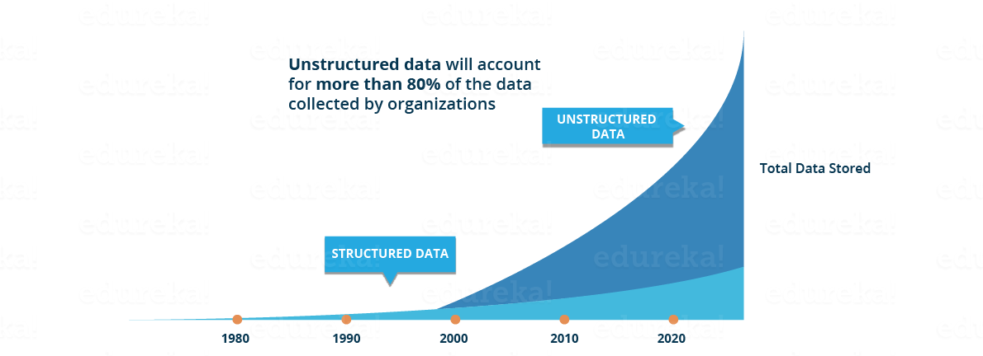
Data Science
Need for data science
https://jeremyronk.wordpress.com/2014/09/01/structured-semi-structured-and-unstructured-data/

Slide 6
Data Science
Need for data science
This data is generated from different sources like financial logs, text files, multimedia forms, sensors, and instruments.
Source - https://www.edureka.co/blog/what-is-data-science/
Simple BI tools are not capable of processing this huge volume and variety of data.
This is why we need more complex and advanced analytical tools and algorithms for processing, analyzing and drawing meaningful insights out of it.
https://www.geeksforgeeks.org/difference-between-structured-semi-structured-and-unstructured-data/
https://www.w3trainingschool.com/structured-semi-structured-unstructured-data

Slide 7
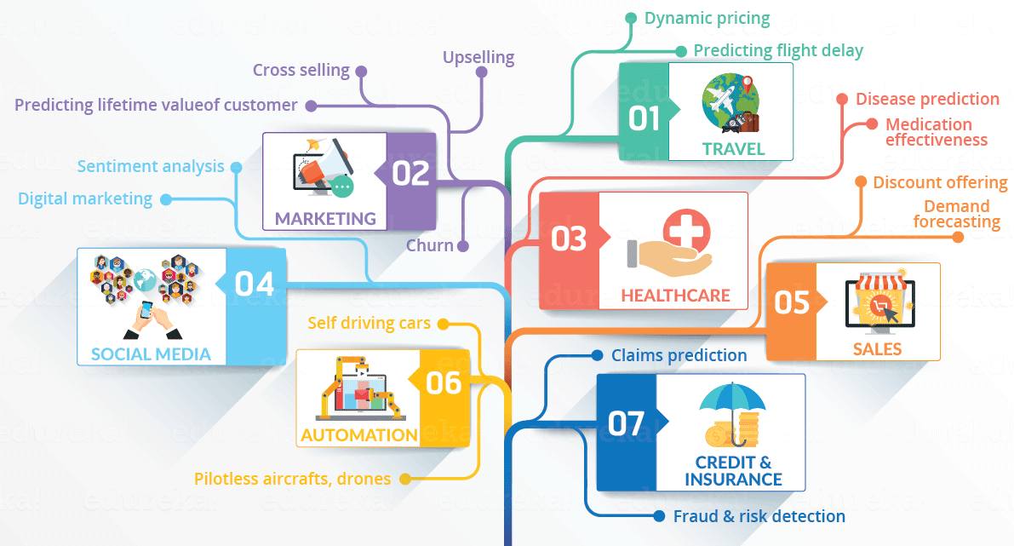
Data Science
Domains currently using data science

Slide 8
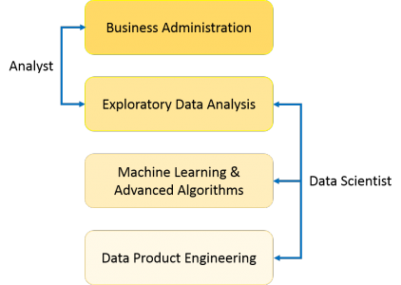
Data Science
What is data science
Data Science is a blend of various tools, algorithms, and machine learning principles with the goal to discover hidden patterns from the raw data, make sense of the data, predicting the future and take business decisions.

Slide 9
Data Science
Predictive causal analytics – If you want a model which can predict the possibilities of a particular event in the future, you need to apply predictive causal analytics.
Example: If you are providing money on credit, then the probability of customers making future credit payments on time is a matter of concern for you. Here, you can build a model which can perform predictive analytics on the payment history of the customer to predict if the future payments will be on time or not.
Prescriptive analytics: If you want a model which has the intelligence of taking its own decisions and the ability to modify it with dynamic parameters, you certainly need prescriptive analytics for it. This relatively new field is all about providing advice. In other terms, it not only predicts but suggests a range of prescribed actions and associated outcomes.
Example for this is Google’s self-driving car which I had discussed earlier too. The data gathered by vehicles can be used to train self-driving cars. You can run algorithms on this data to bring intelligence to it. This will enable your car to take decisions like when to turn, which path to take, when to slow down or speed up.

Slide 10
Data Science
Machine learning for making predictions — If you have transactional data of a finance company and need to build a model to determine the future trend, then machine learning algorithms are the best bet.
This falls under the paradigm of supervised learning. It is called supervised because you already have the data based on which you can train your machines.
For example, a fraud detection model can be trained using a historical record of fraudulent purchases.

Slide 11
Data Science
Machine learning for pattern discovery — If you don’t have the parameters based on which you can make predictions, then you need to find out the hidden patterns within the dataset to be able to make meaningful predictions. This is nothing but the unsupervised model as you don’t have any predefined labels for grouping.
The most common algorithm used for pattern discovery is Clustering. Let’s say you are working in a telephone company and you need to establish a network by putting towers in a region. Then, you can use the clustering technique to find those tower locations which will ensure that all the users receive optimum signal strength.

Slide 12
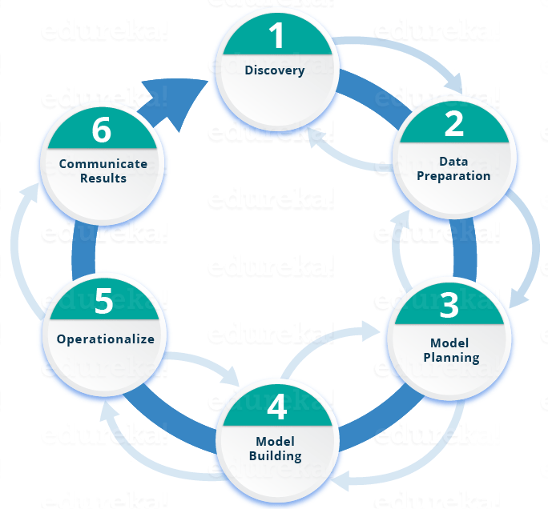
Data Science
Life cycle of data science

Slide 13
Python Data Science
Why Learn Python For Data Science?
Python is no-doubt the best-suited language for a Data Scientist. I have listed down a few points which will help you understand why people go with Python for Data Science:
Python is a free, flexible and powerful open source language
Python cuts development time in half with its simple and easy to read syntax
With Python, you can perform data manipulation, analysis, and visualization
Python provides powerful libraries for Machine learning applications and other scientific computations

Slide 14
Python Data Science
Python Libraries For Data Science
This is the part where the actual power of Python with data science comes into the picture. Python comes with numerous libraries for scientific computing, analysis, visualization etc. Some of them are listed below:
Numpy – NumPy is a core library of Python for Data Science which stands for ‘Numerical Python’. It is used for scientific computing, which contains a powerful n-dimensional array object and provide tools for integrating C, C++ etc. It can also be used as multi-dimensional container for generic data where you can perform various Numpy Operations and special functions.
Pandas – Pandas is an important library in Python for data science. It is used for data manipulation and analysis. It is well suited for different data such as tabular, ordered and unordered time series, matrix data etc.
Matplotlib – Matplotlib is a powerful library for visualization in Python. It can be used in Python scripts, shell, web application servers and other GUI toolkits. You can use different types of plots and how multiple plots work using Matplotlib
Scikit-learn – Scikit learn is one of the main attractions, where in you can implement machine learning using Python. It is a free library which contains simple and efficient tools for data analysis and mining purposes. You can implement various algorithm, such as logistic regression, time series algorithm using scikit-learn.
Reference - https://www.edureka.co/blog/learn-python-for-data-science/

Slide 15
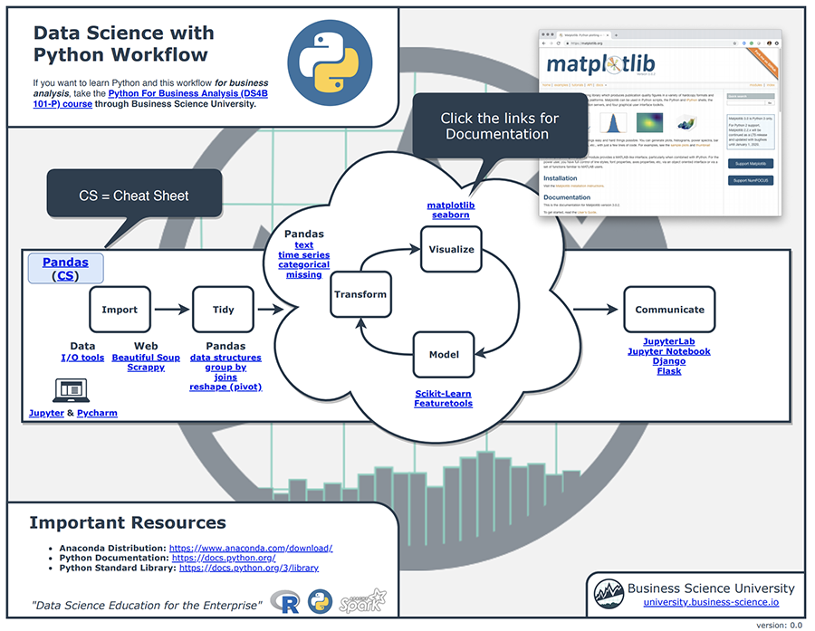
Python Data Science

Slide 16
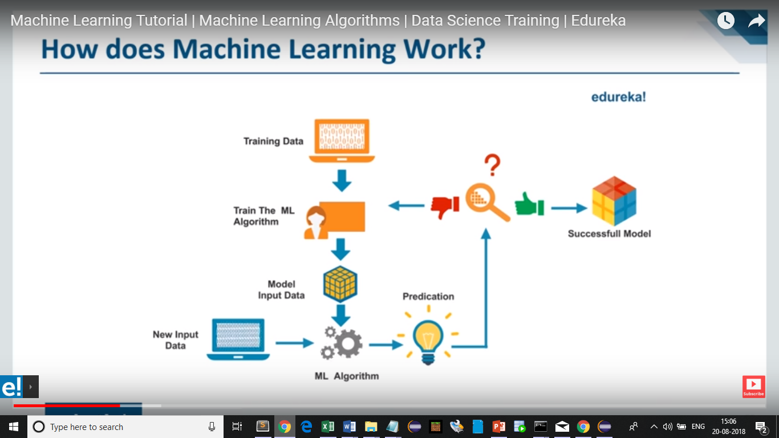
How does machine learning works ?

Slide 17
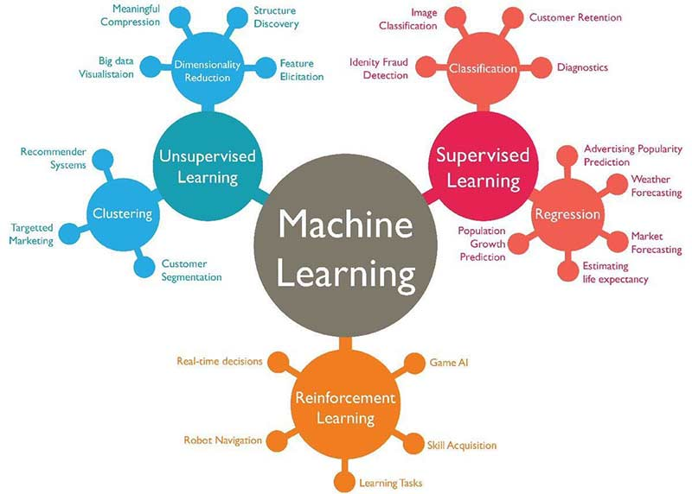
Types of machine learning

Slide 18
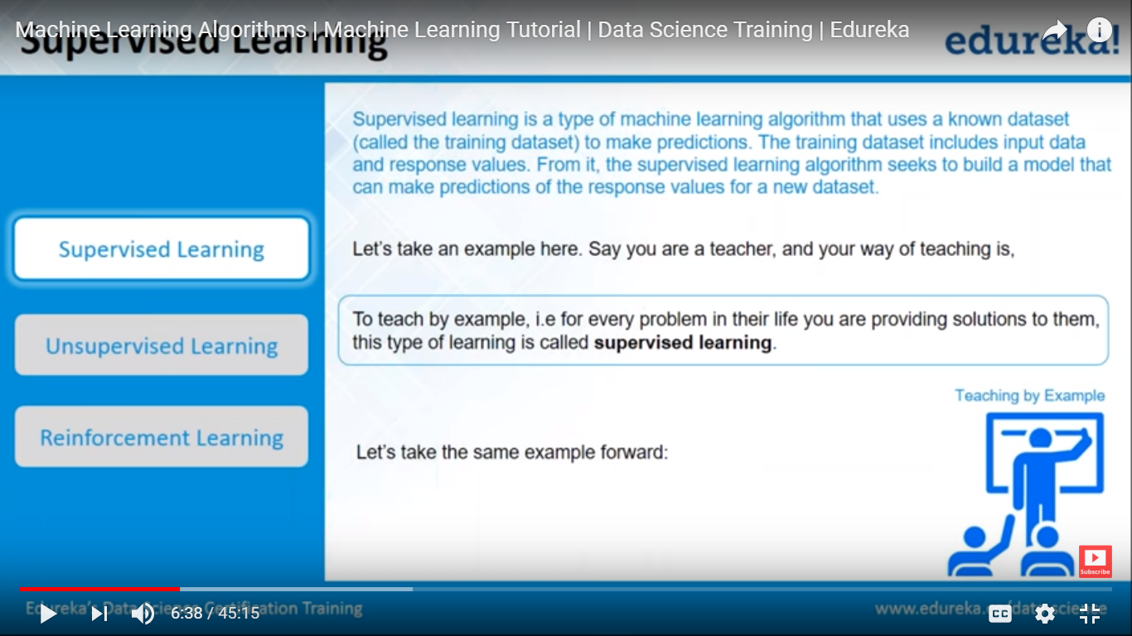
Classification of machine learning

Slide 19
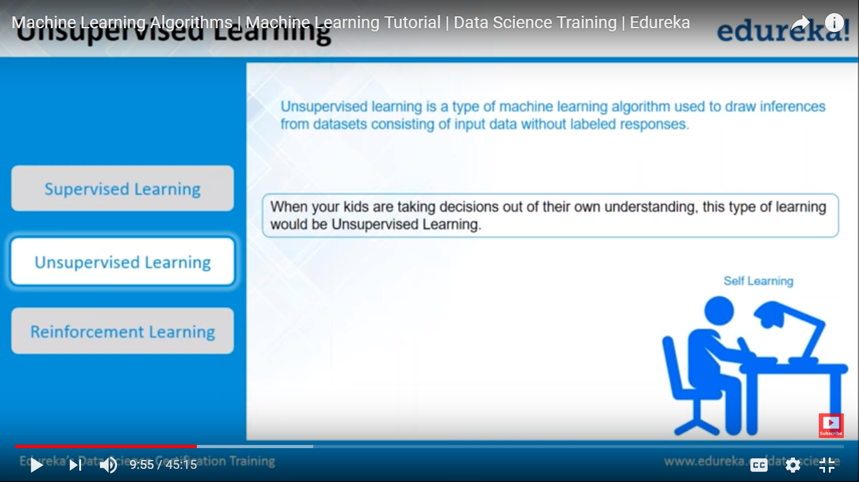
Classification of machine learning

Slide 20
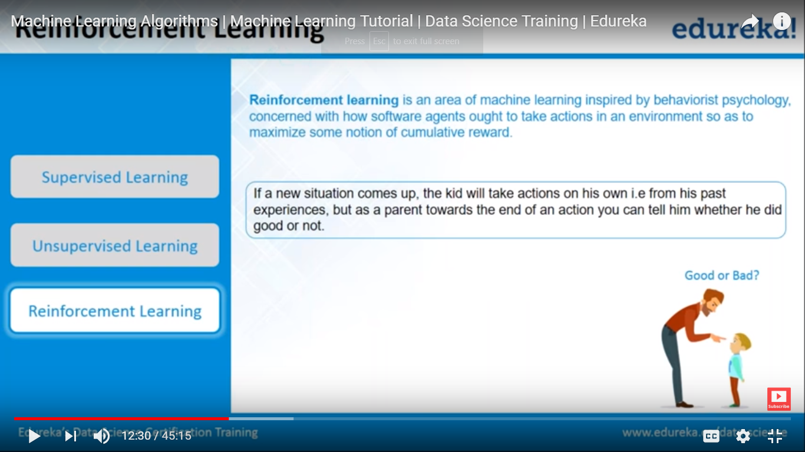
Classification of machine learning

Slide 21
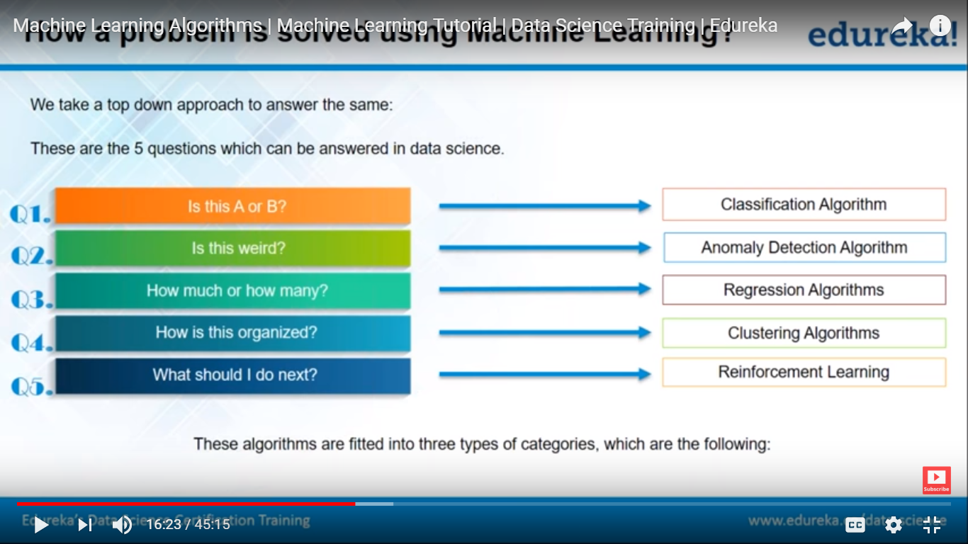
How to solve a problem

Slide 22
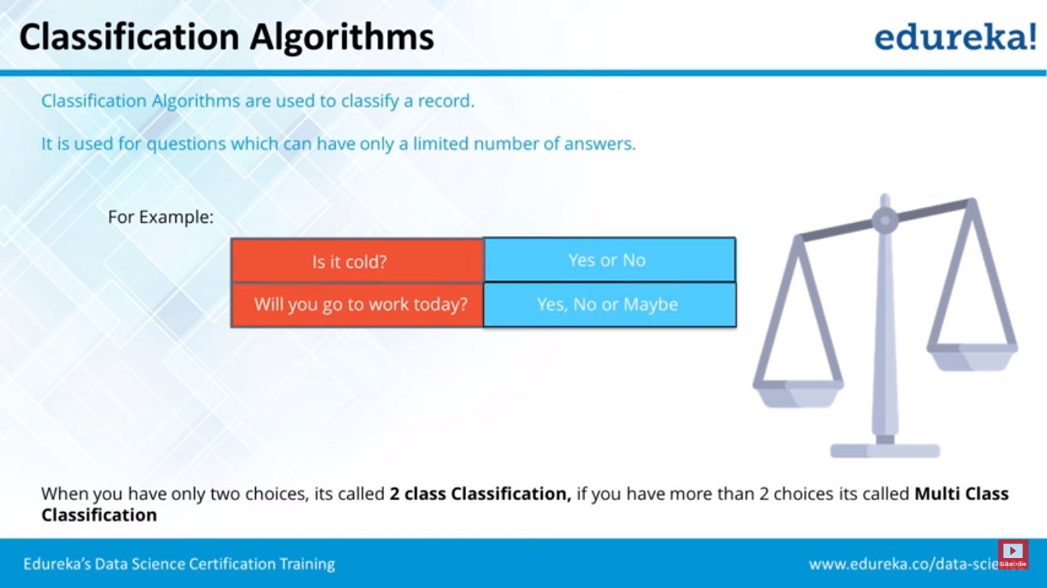
How to solve a problem

Slide 23
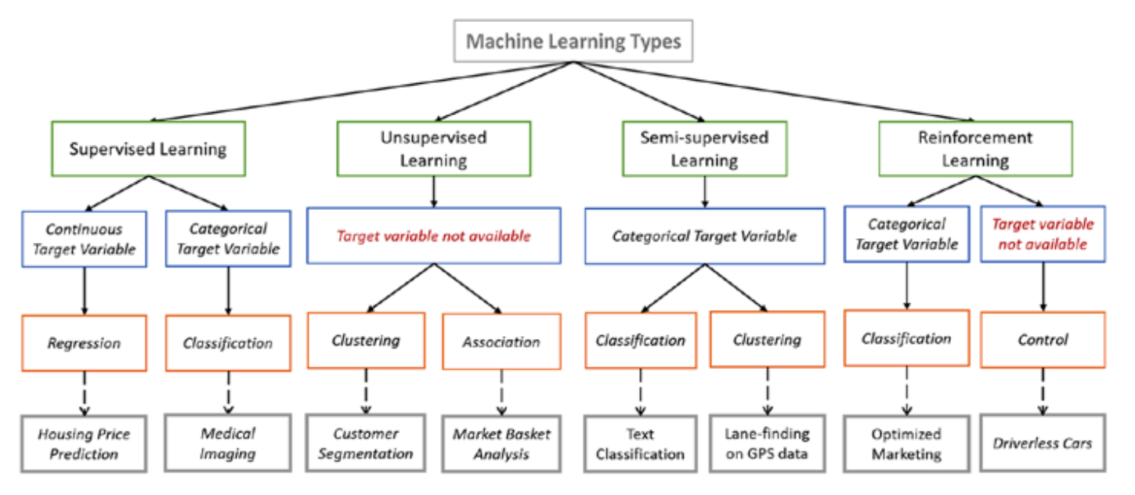
Machine Learning Algorithms

Slide 24
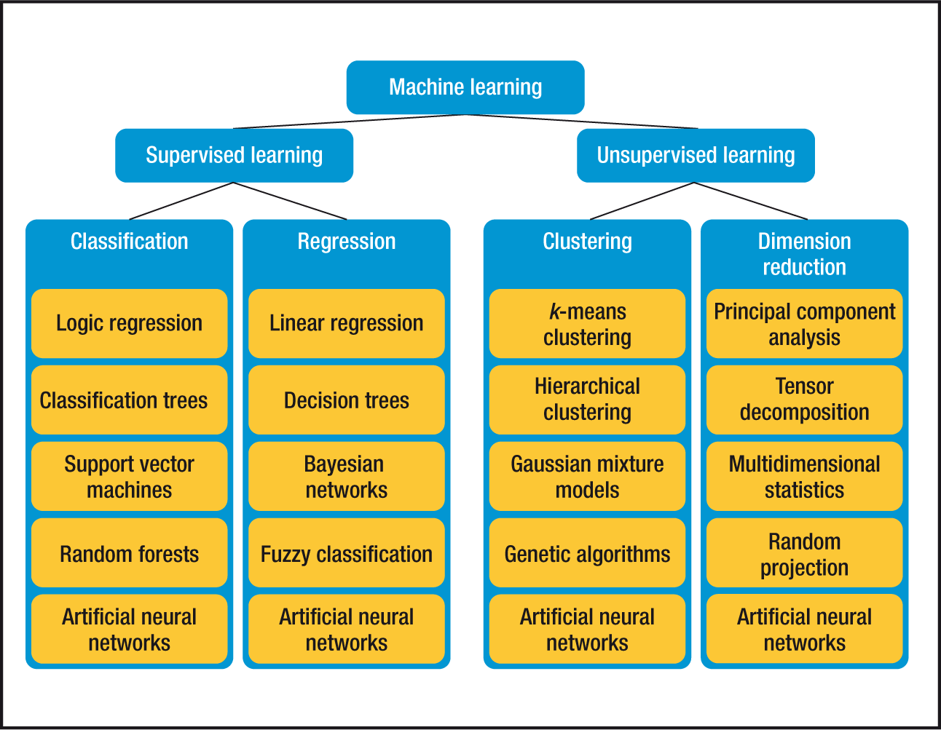
Machine Learning Algorithms

Slide 25

Machine Learning Algorithms

Slide 26
PANDAS
The Pandas library is one of the most preferred tools for data scientists to do data manipulation and analysis, next to matplotlib for data visualization and NumPy, the fundamental library for scientific computing in Python on which Pandas was built.
The fast, flexible, and expressive Pandas data structures are designed to make real-world data analysis significantly easier, but this might not be immediately the case for those who are just getting started with it. Exactly because there is so much functionality built into this package that the options are overwhelming.
https://www.analyticsvidhya.com/blog/2016/01/complete-tutorial-learn-data-science-python-scratch-2/

Slide 27
PANDAS-Cheat Sheet

Slide 28
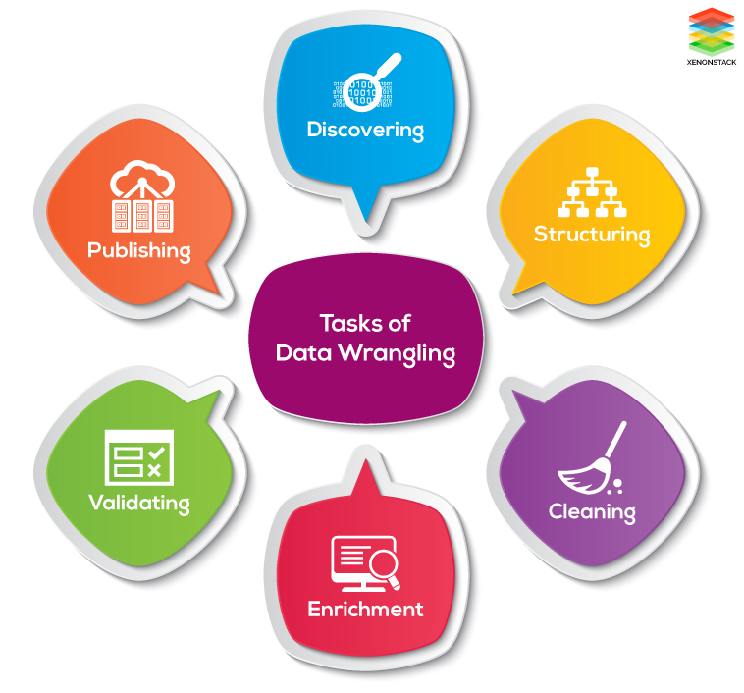
Data wrangling
Data wrangling, sometimes referred to as data munging, is the process of transforming and mapping data from one "raw" data form into another format with the intent of making it more appropriate and valuable for a variety of downstream purposes such as analytics.

Slide 29
NumPy
NumPy is the fundamental package for scientific computing with Python.
It contains among other things:
a powerful N-dimensional array object
sophisticated (broadcasting) functions
tools for integrating C/C++ and Fortran code
useful linear algebra, Fourier transform, and random number capabilities
Besides its obvious scientific uses, NumPy can also be used as an efficient multi-dimensional container of generic data. Arbitrary data-types can be defined. This allows NumPy to seamlessly and speedily integrate with a wide variety of databases.

Slide 30
NumPy-Cheat Sheet

Slide 31
MatplobLib
Data visualization and storytelling with your data are essential skills that every data scientist needs to communicate insights gained from analyses effectively to any audience out there.
Matplotlib is a Python 2D plotting library which produces publication quality figures in a variety of hardcopy formats and interactive environments across platforms. Matplotlib can be used in Python scripts, the Python and IPython shells, the Jupyter notebook, web application servers, and four graphical user interface toolkits.
Matplotlib tries to make easy things easy and hard things possible. You can generate plots, histograms, power spectra, bar charts, errorcharts, scatterplots, etc., with just a few lines of code.

Slide 32
MatplobLib-Cheat Sheet

Slide 33
Thank You

